Slide 1

Mobile Hacking Threats
OWASP Top 10 Mobile Risk
Volume 4, Module 2, v12, with v13 additions at the end

Slide 2

Improper Platform Usage
M1
Platform misuse failure to use security controls provided properly
Misuse of Touch ID and Keychain control

Slide 3

Insecure Data Storage
M2
Wrong assumption by developers that the files system on the portable device are not accessible by others.
Jailbreaking a phone bypasses the security features of the phone or device.
Improper URL caching during the development process.

Slide 4

Insecure Communication
Incorrect SSL versions
Weak negotiation
Cleartext communication
Poor SSL configuration could compromise the device and set the device up for a MITM attack
M3

Slide 5

Insecure Authentication
M4
Bad or weak session management
Failure to identify user when required
Failure to maintain users' identity when required

Slide 6

Insufficient Cryptography
M5
Insufficient Cryptography
Cryptography attempted however but not performed properly
Leads to leaking of sensitive information

Slide 7

Insecure Authorization
M6
Failures in Authorization on the client side of the process
When apps do not authenticate users but allow anonymous authentication to the resource

Slide 8
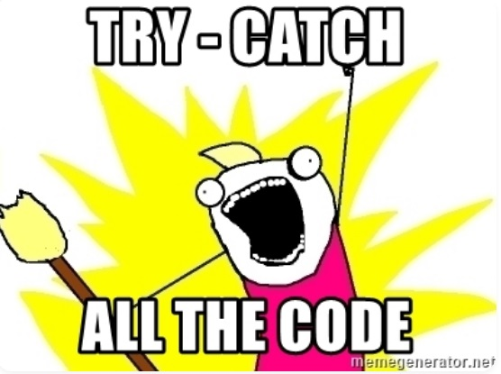
Client Code Quality
M7
Security decisions via untrusted inputs
A catch-all for code-level implementation problems in the mobile client.
Includes buffer overflows format string vulnerabilities
Result from foreign code execution

Slide 9

Code Tampering
M8
Binary patching
Local resource modification
Method hooking
Method swizzling
Dynamic memory modification

Slide 10

Reverse Engineering
M9
Analysis of the final core of the devices binary source code using various tools
Using various methods, the attacker can view the code in real-time identifying weaknesses in the OS or applications associated with it.
Also, possible to identify backdoor servers designed for maintenance or code improvements, that can be used for nefarious purposes.

Slide 11

Extraneous Functionality
M10
Backdoors included by the developer that are hidden
Unintended development security controls
Understanding the extraneous functionality within a mobile app allows the hacker to exploit the relationship between the devices OS and the applications associated with it.

Slide 12
CEHv13 Update – Mobile Threats & Attack Vectors
CEHv13 emphasizes:
  Supply chain and app store attacks, including malicious updates and repackaged apps
  Exploitation of mobile device management (MDM) bypasses
  Use of dynamic instrumentation frameworks like Frida and Xposed for runtime manipulation
Attack vectors now include:
  Abuse of extraneous functionality (OWASP M10)
  Reverse engineering APKs/IPAs for backdoor discovery and credential theft
  Exploitation of platform-specific APIs, biometric spoofing, and insecure webviews

Slide 13
CEHv13 Update – Mobile Platform Defense & Standards
CEHv13 promotes best practices aligned with:
  OWASP Mobile Top 10 (e.g., M1–M10: Improper Platform Usage, Insecure Storage, Code Tampering)
  Zero Trust Mobile Device Security using conditional access and behavioral policies
Key defenses include:
  Enforcing certificate pinning and encrypted storage
  Implementing MDM policies for app sandboxing, remote wipe, and device compliance
  Monitoring mobile app traffic for runtime anomalies using tools like MobSF and QARK
Emphasis on developer-secure coding and post-market monitoring

